Slide 1
CH 5
Lists

Slide 2
Introduction
List is a sequential data structure in which addition and removal of data items can be done from any position.
List is a collection of nodes.
The List is an :
Ordered sequence of data items called elements
A1, A2, A3, ...,AN is a list of size N
Size of an empty list is 0
A_{i+i} succeeds A_{i}
A_{i-1} precedes A_{i}
Position of A_{i}, is i
First element is A₁ called "head"
Last element is A_{N} called "tail"

Slide 3
List as an ADT
A List L is defined as the collection of items of type T with the following operations:
Initialize: Creates a new empty List
Add : adds a new node to the list
Set : update the contents of a node
Remove : removes a node
IsEmpty : reports whether the list is empty
IsFull : reports whether the list is full
Destroy : deletes the contents of the list

Slide 4
List operations
Initialize(L) - Create a new empty List named L
Add( 1 ,X,L) - Adds the value X to list L at position 1 (the start of the list is position 0), shifting subsequent elements up
Set(2,Z,L) - Updates the values at position 2 to be Z
Remove(Z,L) - Removes the element with value Z
Get(2,L) - returns the value of the third node
IndexOf(X,L) - returns the index of the node with value X

Slide 5




List operations[2]
Add( 1 ,X,L)
Set(2,Z,L) -
Remove(Z,L)
Get(2,L) = C
IndexOf(X,L) = 1

Slide 6
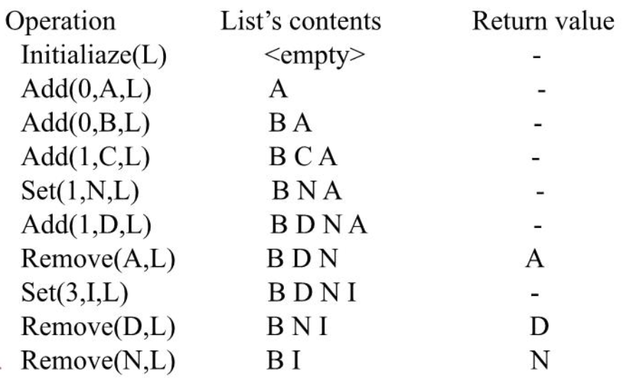
Example of operation

Slide 7
List Implementation
Static List Implementation
Dynamic List Implementation

Slide 8
Static List
Static list implementation is done by storing the items in an array.
The position of the element is given by an index starting with 0 to n-1, where n is the number of elements.
Static list is of fixed size.
Operations on static list are:
Given an index, the element of that position can be accessed at constant time, without any relation with the size of the list.
To add an element at the end of the list, it can also be done at constant time. Adding an element ar any other position involves shifting up one position of all the subsequent elements, so the time complexity depends on the size of the list.
Removing an item from the list involves shifting all the elements down by one position, so the time complexity depends on the size of the list.

Slide 9
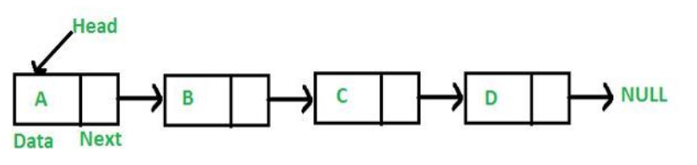
Dynamic List
In dynamic list, the size of the list is not fixed and can be modified during the operations performed on it.
Dynamic data structures are designate to facilitate the change of data structures in the run time.
Example of dynamic list: Linked list.

Slide 10
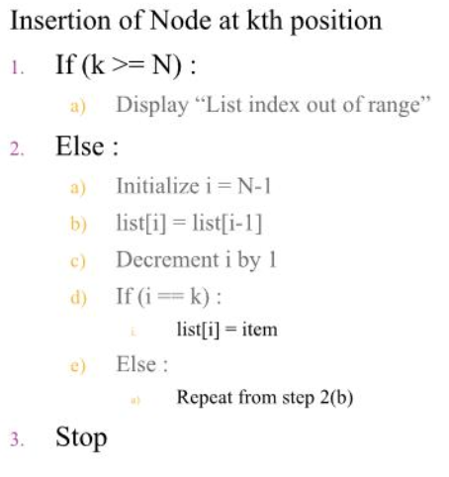
Array Implementation of list
Supposing a list of fixed size N, ie, index ranges from 0 to N-1.
Insertion of Node at k^{th} Position.

Slide 11
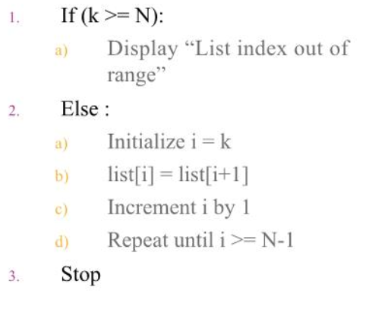
Array Implementation of list [2]
Supposing a list of fixed size N, ie, index ranges from 0 to N-1.
Deletion of Node at k^{th} Position.

Slide 12
Array Implementation of list [3]
Advantages of array implementation
Variables are stored in contiguous memory locations
Easy to handle data
Limitations
Hard to add/remove elements in place.
Cannot be dynamically resized
Memory loss might be a problem.

Slide 13
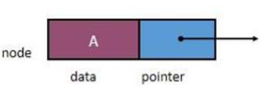
Linked List
A linked list is a linear collection of data elements, called nodes, where the linear order is given by means of pointers.
Each node contains two parts:
The first part contains the information of the element, and
The second part contains the address of the next node in the list.

Slide 14
Advantages / disadvantages of Linked List
Advantages
Dynamic Size
Ease of insertion/deletion.
Disadvantages
Random access is not allowed. Elements need to be accessed sequentially starting from the first node.
Extra memory space for next pointer is required.

Slide 15
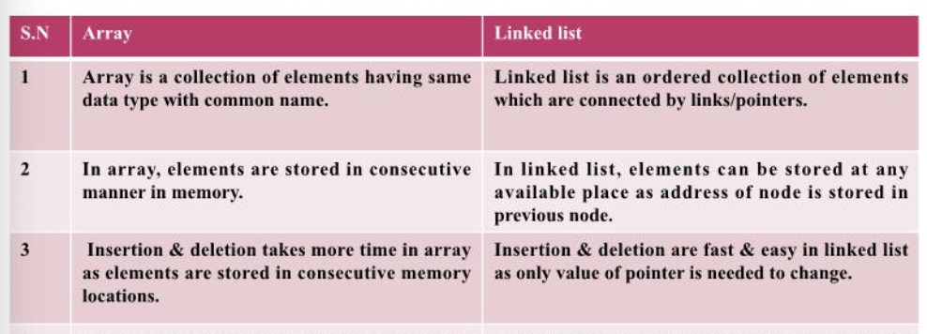
Array vs Linked List

Slide 16
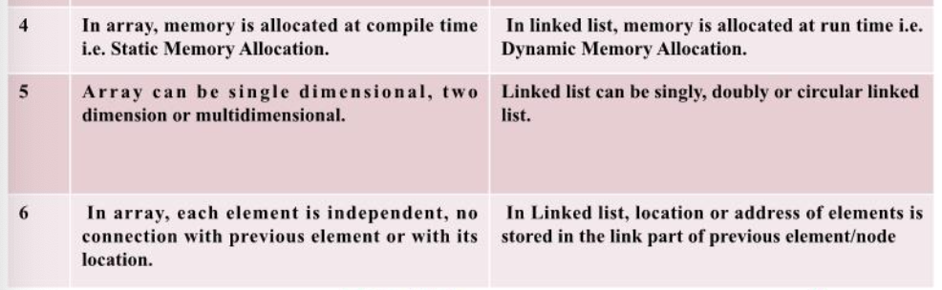
Array vs Linked List[2]

Slide 17
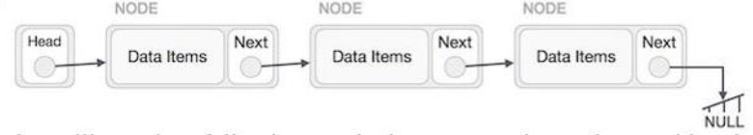
Representation of Linked list
Linked list can be visualized as a chain of nodes, where every node in the list points to the next node.
The first node is called head. If the linked list is empty, then the value of head is NULL.
To represent a linked list, we require a link element called first.
Each node includes a data field and a link field called next.
Each node is linked with its next node using the next field.
The last node has NULL in its next field to mark the end of the list.

Slide 18
Linked list as an ADT
A linked list L is a collection of nodes which has a link to the next node in the list and having the following operations:
INITIALIZE - initialize an empty linked list
TRAVERSE - traverse the linked list
SEARCH - search for an item in linked list
COUNT - count the number of items in linked list
CONCAT - concatenation of two linked lists
ADD - add element into linked list ( start, end or specific position)
DELETE - remove item from linked list (start, end or specific position)
UPDATE - update specific element

Slide 19
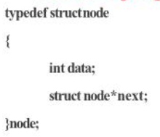
Creating linked list
Linked list is created using Dynamic Memory Allocation
First define linked list node as a structure:

Slide 20
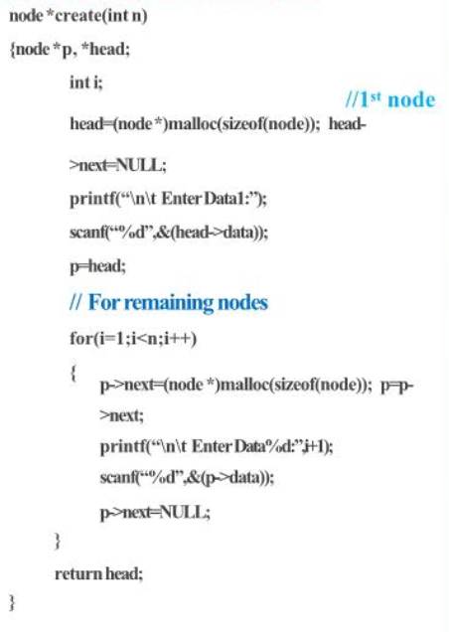
Creating linked list[2]
Then create function is defined as:

Slide 21
Traversing linked list
Traversing of linked list always starts with first node.
Initially pointer type variable is assigned to first node ie, HEAD. P = HEAD;
To travel the list in the forward direction, pointer is travelled through all the nodes.
Stop at the node where the value of next is NULL.
P = HEAD while(p!=NULL) P = p->next;

Slide 22
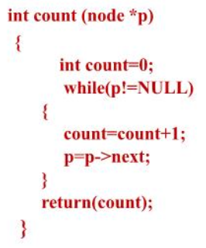
Counting the number of nodes
Start by taking a variable count and initialize to 0.
Traverse the linked list from strat node to last node and for each node, increment count.

Slide 23
Printing all nodes
Traverse the linked list from start to last node and print each node.
Void print(node *p) { while(p!=NULL) { printf(“%d”,p->data); p=p->next; }
}

Slide 24
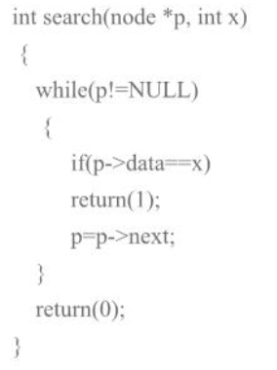
Search element
In order to search an element in linked list, we start traversing from the first node.
Traversal ends with success if element is found, if not it ends with failure.

Slide 25
Concatenating two linked lists
Step1: Start Step2: Assume that the two linked list has two different heads as- HEAD1 & HEAD2
Step 3: If the first linked list is empty, return HEAD2, Step 4: If the second linked list is empty, return HEAD1
Step 5: Store the address of HEAD1 in pointer variable say P.
Step 6: Start traversing first linked list using HEAD1 and go to the last node whose next field is NULL and replace that NULL with HEAD2.
Step 7: Return HEAD1.
Step 8: Stop

Slide 26
Types of Linked List
Singly Linked list
Doubly linked list
Circular Linked list
Singly circular linked list
Doubly circular linked list

Slide 27
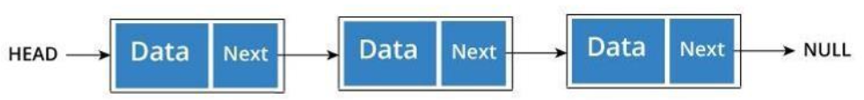
Singly Linked list
The individual element is termed “Node”.
Every Node consists of two fields, data & next.
The data field is used to store actual value of that node while the next field is used to store the address of the next node in the sequence.
Only one link is present in each node. The link of the last node has a NULL pointer.

Slide 28
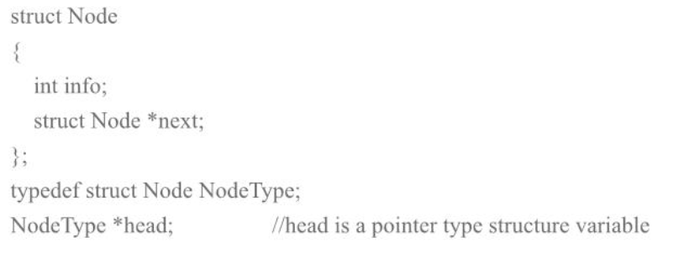
Representation of Singly linked list
We can create a structure for the representation of singly linked list where each node has two members - the data item and the address of next node.

Slide 29
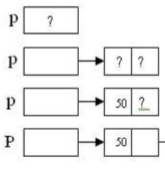
Operation of Singly linked list
Creation of singly linked list - Use malloc
After creation of the node, store the new item in the node using pointer. Node *p
P = (Node*)malloc(sizeof(Node));
P->data = 501;
p->next = NULL;

Slide 30
Operation of Singly linked list[2]
Inserting nodes
To insert an element or a node in a linked list, the following steps are done:
Allocate a node
Assign a data into the data field of the node
Adjust the pointer
Insertion can be done in 3 ways:
Inserting at beginning of the list
Inserting at the end of the list
Inserting at specific position in the list.

Slide 31
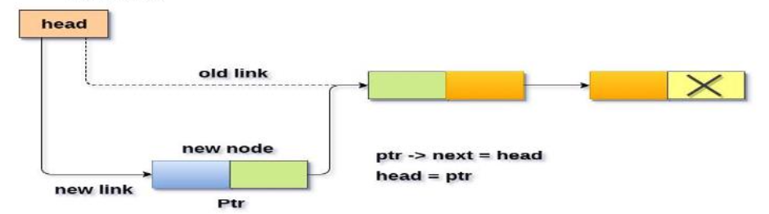
Operation of Singly linked list[2]
Inserting nodes at beginning of the linked list
To insert an element or a node at the beginning of the linked list, the following steps are done:
Create a new node (newNode) with given value
Check whether the list is empty (HEAD == NULL)
If it is empty then, set newNode->next = NULL and HEAD = newNode.
If it is not empty then, set newNode->next = HEAD and head = newNode.

Slide 32
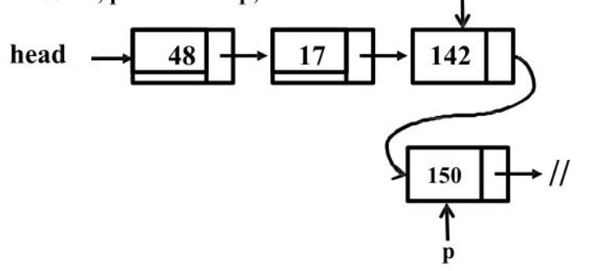
Operation of Singly linked list[3]
Inserting nodes at last of the linked list
To insert an element or a node at the end of the linked list, the following steps are done:
Create a new node (newNode) with given value and newNode->next = NULL
Check whether the list is empty (HEAD == NULL)
If it is empty then, set newNode->next = NULL and HEAD = newNode.
If it is not empty then, go to the last node of the linked list and set p->next= newNode.

Slide 33
Operation of Singly linked list[4]
Inserting nodes in place after a node
To insert an element or a node at a position of the linked list, the following steps are done:
Create a new node (newNode) with given value and newNode->next = NULL
Check whether the list is empty (HEAD == NULL)
If it is empty then, set newNode->next = NULL and HEAD = newNode.
If it is not empty then, go to the specific node after which we want to insert the newNode of the linked list.
Everytime check whether p has reached to the last node or not. If the last node is reached display ‘Given node is not found in the list’ and exit.
Finally set newNode->next = p->next and p->next= newNode

Slide 34
Operation of Singly linked list[5]
Deleting a node
To delete a node from the linked list, the following steps are done:
Find the previous node of the node to be deleted
Change the next of previous node
Free the memory for the node to be deleted.
Deletion can be performed in 3 ways:
Deleting from beginning of the list
Deleting from the end of the list
Deleting a specific node

Slide 35
Operation of Singly linked list[6]
Deleting a node from beginning of the linked list:-
To delete a node from the begining of the linked list, the following steps are done:
Check whether the linked list is empty
If it is empty then, display ‘List is empty, delete is not possible’ and exit
If it is not empty then define a node pointer ‘p’ and initialize it with HEAD.
Check whether the list is having only one node (p->next == NULL)
If so, then set HEAD = NULL and delete p ( free )
If not, then set HEAD = p->next and delete p.

Slide 36
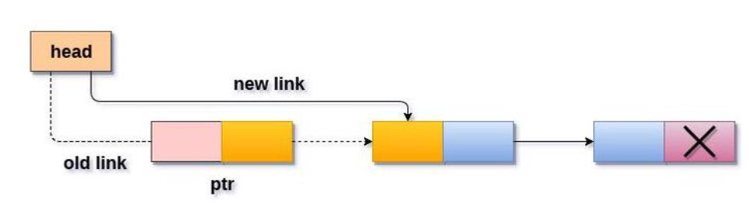
Operation of Singly linked list[7]
Deleting a node from beginning of the linked list:-
To delete a node from the begining of the linked list, the following steps are done:

Slide 37
Operation of Singly linked list[8]
Deleting a node from end of the linked list:-
To delete a node from the begining of the linked list, the following steps are done:
Check whether the linked list is empty
If it is empty then, display ‘List is empty, delete is not possible’ and exit
If it is not empty then define two node pointers ‘p’ and ‘q’ and and initialize p with HEAD.
Check whether the list is having only one node (p->next == NULL)
If so, then set HEAD = NULL and delete p ( free )
If not, then set q=p and move p to its next node. Repeat the same until it reaches to the last node in the list ie, p->next == NULL.
Finally, set q->next = NULL and delete p.

Slide 38
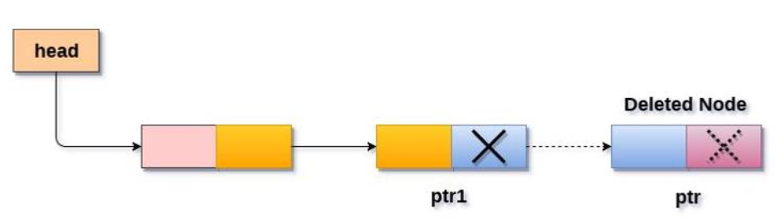
Operation of Singly linked list[8]
Deleting a node from end of the linked list:-
To delete a node from the begining of the linked list, the following steps are done:

Slide 39
Operation of Singly linked list[8]
Deleting a specific node of the linked list:-
To delete a specific node of the linked list, the following steps are done:
Check whether the linked list is empty
If it is empty then, display ‘List is empty, delete is not possible’ and exit
If it is not empty then define two node pointers ‘p’ and ‘q’ and and initialize p with HEAD.
Keep moving the p until it reaches the exact node to be deleted or to the last node. At every loop, set q=p before moving p to its next node.
If it reached to the exact node, which we want to delete, then check whether list is having only one node or not
If the list has only one node and that is the node to be deleted, then set HEAD = NULL and delete p.
If the list contains multiple nodes, then check whether p is the first node in the list, if so then move the head to the next node
If p is not the first node then check whether it is last node in the list
If p is not first and not last node then set q->next = p->next and delete p.

Slide 40
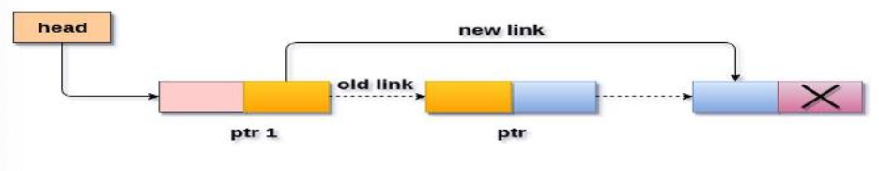
Operation of Singly linked list[8]
Deleting a specific node of the linked list:-
To delete a specific node of the linked list, the following steps are done:

Slide 41
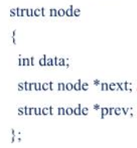

Doubly linked list
Doubly linked list is a complex type of linked list in which a node contains a pointer to the previous as well as the next node in the sequence.
Therefore, in a doubly linked list, a node consists of three parts:
node data
pointer to the next node in sequence (next pointer)
pointer to the previous node (previous pointer).
Pointers exist between adjacent nodes in both directions.The list can be traversed either forward or backward.
Usually two pointers are maintained to keep track of the list, head and tail.

Slide 42
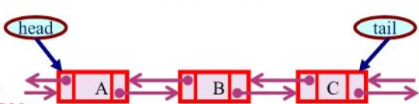
Doubly linked list - Representation

Slide 43
Advantages of DLL over SLL
A DLL can be traversed in both forward and backward direction.
The delete operation in DLL is more efficient if pointer to the node to be deleted is given.
In DLL, to delete a node, pointer to the previous node is needed.
To get this previous node, sometimes the list is traversed. In DLL, we can get the previous node using previous pointer.

Slide 44
Disadvantages of DLL over SLL
Every node of DLL Require extra space for an previous pointer.
All operations require an extra pointer previous to be maintained.
For example, in insertion, we need to modify previous pointers together with next pointers.

Slide 45
Operation on DLL
Insertion of a new node at beginning of DLL
Create a newNode with given value and newNode —> previous as NULL.
Check whether list is Empty (head = NULL)
If it is Empty then, assign NULL to newNode —> next and newNode to head.
If it is not Empty then, assign head to newNode —> next and newNode to head.

Slide 46


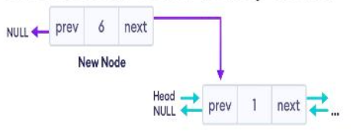
Operation on DLL[2]
Insertion of a new node at beginning of DLL
Adding a node with value 6 at the begining of a DLL:

Slide 47
Operation on DLL[3]
Insertion of a new node at beginning of DLL
Adding a node with value 6 at the begining of a DLL:
Create a new node
Set prev and next pointers
Make new node as head node

Slide 48
Operation on DLL[4]
Insertion of a new node after a node in DLL
Create a newNode with given value.
Check whether list is Empty (head = NULL)
If it is Empty then, assign NULL to newNode previous & newNode —> next and newNode to head.
If it is not Empty then, define two node pointers tempi & temp2 and initialize tempi with head.
Keep moving the tempt to its next node until it reaches to the node after which we want to insert the newNode (until tempi->data is equal to location, here location is the node value after which we want to insert the newNode).
Every time check whether tempi is reached to the last node. If it is reached to the last node then display 'Given node not found!!! Insertion not possible!!!' and exit. Otherwise move the temp1 to next node.
Assign tempi —+ next to temp2, newNode to tempi —* next, tempi to newNode previous, temp2 to newNode --+ next and newNode to temp2 —4 previous.

Slide 49


Operation on DLL[5]
Insertion of a new node after a node in DLL
Create a new node
Set the next pointer of new node and previous node
Set the previous pointer of new node and the next node

Slide 50
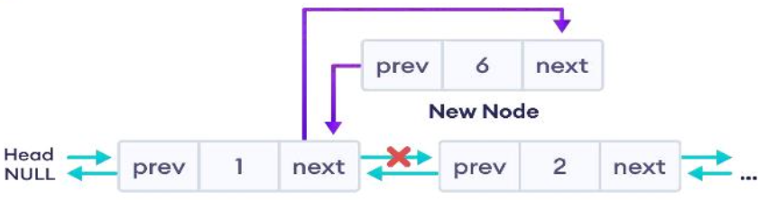
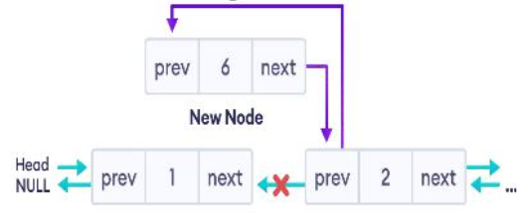
Operation on DLL[6]
Insertion of a new node after a node in DLL

Slide 51
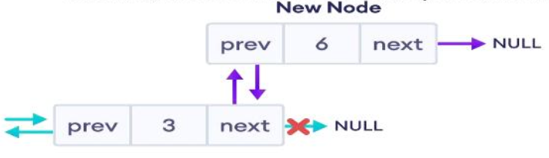
Operation on DLL[7]
Insertion of a new node at the end in DLL

Slide 52
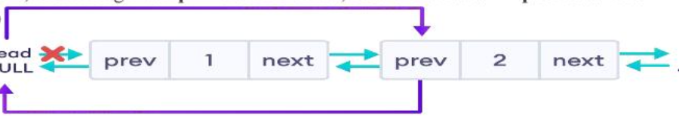
Operation on DLL[8]
Delete a node from the beginning in DLL
Check whether the list is EMPTY
If it is empty, then display ‘List is empty, cant delete’ and exit.
If it is not empty, then define a Node pointer “p” and initialize with head.
Check whether the list is having only one element, (p->next = p->previous = NULL)
If it is true, then set HEAD to NULL and delete p.
If it is false, then assign p->next to head, NULL to head->previous and delete p.

Slide 53
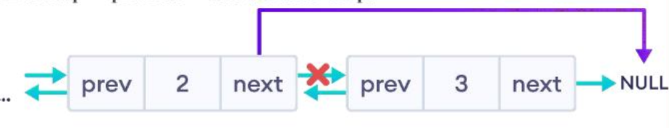
Operation on DLL[9]
Delete a node from the endend in DLL
Check whether the list is EMPTY
If it is empty, then display ‘List is empty, cant delete’ and exit.
If it is not empty, then define a Node pointer “p” and initialize with head.
Check whether the list is having only one element, (p->next = p->previous = NULL)
If it is true, then set HEAD to NULL and delete p.
If it is false, then keep moving p until it reaches to the last node in the list.
Assign q= p->previous and q->next = NULL and then delete p.
Set q= p->previous and q->next = NULL and delete p.

Slide 54
Operation on DLL[10]
Delete of a specific node in DLL
Check whether the list is EMPTY
If it is empty, then display ‘List is empty, cant delete’ and exit.
If it is not empty, then define a Node pointer “p” and initialize with head.
Check whether the list is having only one element, (p->next = p->previous = NULL)
If it is true, then set HEAD to NULL and delete p.
If it is false, then keep moving p until it reaches to the last node in the list.
Set q= p->previous and q->next = NULL and delete p.

Slide 55
Operation on DLL[9]
Delete of a node a the beginning in DLL
Check whether the list is EMPTY
If it is empty, then display ‘List is empty, cant delete’ and exit.
If it is not empty, then define a Node pointer “p” and initialize with head.
Check whether the list is having only one element, (p->next = p->previous = NULL)
If it is true, then set HEAD to NULL and delete p.
If it is false, then assign p->next to head, NULL to head->previous and delete p.

Slide 56
Operation on DLL[10]
Delete of a specific node in DLL
Check whether the list is EMPTY
If it is empty, then display ‘List is empty, cant delete’ and exit.
If it is not empty, then define a Node pointer “p” and initialize with head.
Keep moving p until it reaches to the exact node to be deleted or to the last node
If it reached to the last node, then display ‘Given node not found’ and exit.
If it reached to the exact node, then check whether list is having only one node.
If list has only one node and that is the node to be deleted, then set HEAD to NULL and delete p.
If list contains multiple nodes, then check whether p is the first node in the list.
If p is the first node, then move the head to the next node, set head of previous to NULL and delete p.
If p is not the first node, check whether it is the last node in the list.
If p is the last node then set temp of previous of next to NULL and delete p.
If p is not the first node nor the last node, then set p of previous of next to p of next: ie p->previous->next = p->next, p of next of previous to p of previous and delete p.

Slide 57
Operation on DLL[10] …

Slide 58
Operation on DLL[11] …
Displaying the elements of a DLL:
Check whether the list is EMPTY
If it is empty, then display ‘List is empty’ and exit.
If it is not empty, then define a Node pointer “p” and initialize with head.
Keep moving p to the next node until p reaches to the last node
At each step display p->data.

Slide 59
DLL Applications
Redo and undo functionality in editor softwares.
Forward and backward navigation in browsers
For navigation systems where forward and backward navigation is required.

Slide 60
Circular Linked List
A circular linked list is basically a linear LL that may be single or double linked.
The only difference from linear one is that there is no any NULL value terminating the list.
In fact every node in the list points to the next node and the last node points to the first node, thus forming a circle. Since it forms a circle with no end to stop, it is called circular LL.
In circular LL, there can be no starting or ending node, whole list can be traversed from any node.
In order to traverse, we only need to traverse the entire list until the starting node is not traversed again.
A circular LL can be implemented using both singly LL and DLL.

Slide 61
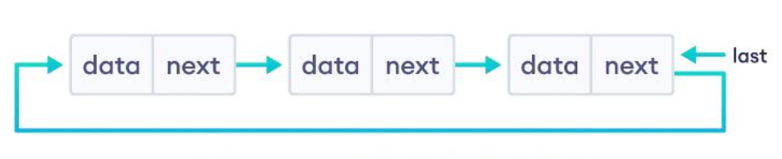
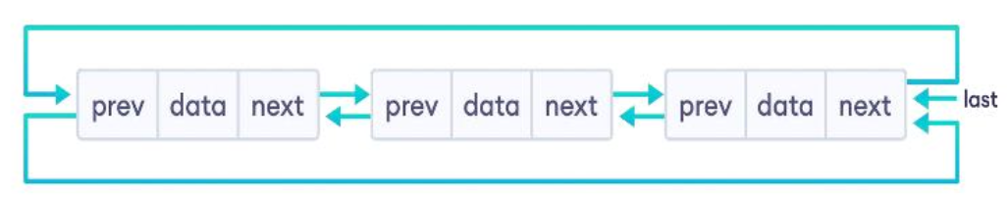
Circular Linked List [1]

Slide 62
Circular Linked List [2]
Advantages
Entire list can be traversed from any node
Helps to access in a circle or loop
Despite using single linked list, we can traverse to its previous node.
Disadvantages
Complex compared to linear LL
Reversing operations is also complex
If not traversed carefully, then we could end in an infinite loop.
Only support sequential access of elements.

Slide 63
Operations on Circular Linked List
Insert - insert an element at the start of the circular linked list.
Delete - delete an element from the start of the circular linked list.
Display - display the elements in the list.

Slide 64
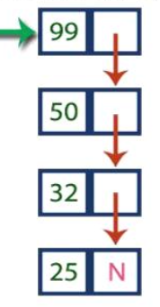
Stack as Linked List
Problem with array implementation => fixed size
The stack implemented using Linked list can work for an unlimited number of data.
In linked list implementation of a stack, every new element is inserted as “top” element.
Removing an element from the stack will remove the node pointed to be top and top is moved to the next node in the list.
The next field of the first element will always be NULL.

Slide 65
Stack as Linked List[2]
Push(value, stack)
Create a newNode with given value
Check whether the stack is EMPTY (top == NULL)
If it is EMPTY, then set newNode->next = NULL
If it is not EMPTY, then set newNode->next = top
Finally, set top = newNode

Slide 66
Stack as Linked List[3]
Pop(stack)
Check whether stack is EMPTY (top ==NULL)
If it is EMPTY, then display “Stack is Empty, cant pop” and exit.
If it is Not EMPTY, then define a node pointer “p” and set it to “top”
Then set top = top->next.
Delete the node “p”.

Slide 67
Stack as Linked List[4]
Display(stack)
Check whether stack is EMPTY (top ==NULL)
If it is EMPTY, then display “Stack is Empty” and exit.
If it is Not EMPTY, then define a node pointer “p” and set it to “top”
Display p->data and move to next node
Repeat the same until p reaches to the first node in the stack ie: p->next != NULL

Slide 68

Queue as Linked List
Problem with array implementation => fixed size
The queue implemented using Linked list can work for an unlimited number of data.
In linked list implementation of a queue, every new element is inserted as “rear” element and the first node is always pointed to by “front”.
Removing an element from the stack will remove the node pointed to be front and front is moved to the next node in the list.
The next field of the last inserted element will always be NULL.

Slide 69
Queue as Linked List [2]
Operation Enqueue(x,q)
Create a newNode with given value and set newNode->next to NULL
Check whether queue is EMPTY (rear == NULL)
If it is EMPTY then, set front = newNode & rear = newNode
If it is not EMPTY then, set rear->next = newNode and rear = newNode.
Dequeue()
Check whether the queue is EMPTY (front == NULL)
If it is EMPTY, then display “Queue is empty, dequeue is not possible” and exit.
If it is not EMPTY then, define a node pointer “p” and set it to “front” ie p=front.
Set front = front->next and delete “p”

Slide 70
Queue as Linked List [3]
Operation Display(q)
Check whether the queue is EMPTY (front == NULL)
If it is EMPTY, then display “Queue is empty, no elements to display” and exit.
If it is not EMPTY then, define a node pointer “p” and set it to “front” ie p=front.
Display p->data and move it to the next node ie p=p->next.
Repeat the process until p reaches to rear ie (p->next != NULL).

